Slide 1
Production & Costs in the Short-run

Slide 2
Total, Marginal & Average Product
    Total Product (TP): is the total quantity of output produced by a firm
    Marginal Product (MP): is the extra or additional output resulting from one additional unit of the variable input
        It tells us by how much output increases as labour increases by one worker.
        MP = ∆TP ÷ ∆Labour
    Average Product (AP): is the total quantity of output per unit of variable input, or labour
        This tells us how much output each unit of labour produces on average
        AP = TP ÷ Labour

Slide 3
Example; TP, MP and AP
Labour (L) | Total Product (TP) | Marginal Product (MP) MP = ∆TP ÷ ∆Labour | Average Product (AP) AP = TP ÷ Labour
0 | 0 | − | −
1 | 2 | 2 | 2
2 | 5 | 3 | 2.5
3 | 9 | 4 | 3
4 | 14 | 5 | 3.5
5 | 18 | 4 | 3.6
6 | 21 | 3 | 3.5
7 | 23 | 2 | 3.3
8 | 24 | 1 | 3
9 | 24 | 0 | 2.7
10 | 23 | − 1 | 2.3
11 | 21 | − 2 | 1.9

Slide 4
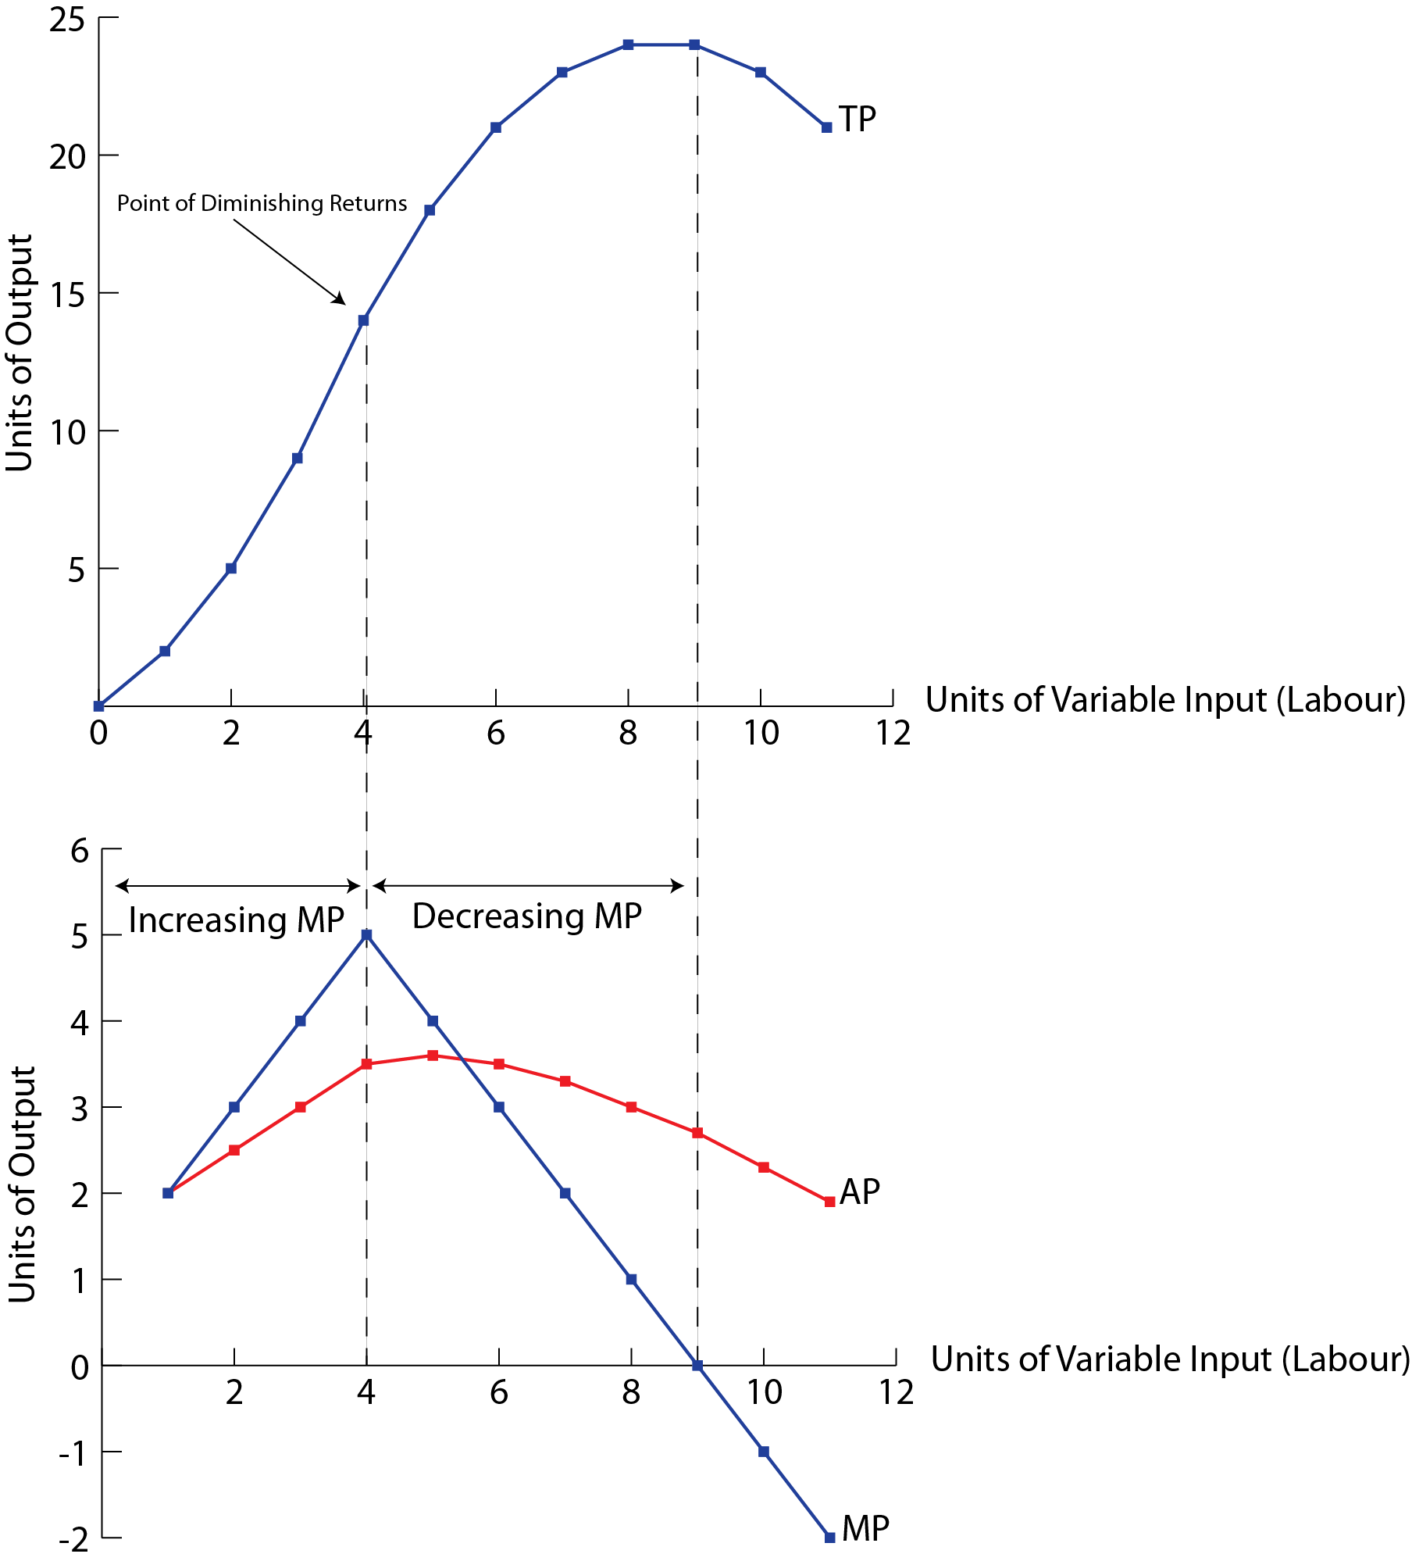
    Law of Diminishing Returns: as more and more units of a variable input (such as labour) are added to one or more fixed inputs (such as land), the marginal product of the variable input at first increases, but there comes a point when it begins to decrease

Slide 5
Economic Costs
    Economic Costs: are the sum of explicit and implicit costs, or total opportunity costs incurred by a firm for its use of resources, whether purchases or self-owned.
        Economic Costs = Explicit Costs + Implicit Costs
        When economists refer to ‘costs’ they mean ‘economic costs’
    Explicit Costs: payments made by a firm to outsiders to acquire resources for use in production
    Implicit Costs: the sacrificed income arising from the use of self-owned resources by a firm

Slide 6
Short-Run Costs
    Fixed Costs (FC): arise from the use of fixed inputs. Fixed costs are costs that do not change as output changes.
        Example; Rental payments, property taxes, insurance premiums
    Variable Costs (VC): arise from the use of variable inputs. These costs change as output increases or decreases.
        Example; Wage cost of labour
    Total Costs: in the short-run, a firm’s total costs are the sum of fixed and variable costs.
        In the long-run there are no fixed costs, therefore a firm’s total costs are equal to its variable costs
        TC = TFC + TVC

Slide 7
Average and Marginal Costs
    Average Costs: are costs per unit of output, or total cost divided by the number of units of output.
        AFC = TFC ÷ Q (Average fixed costs)
        AVC = TVC ÷ Q (Average variable costs)
        ATC = TC ÷ Q
        = AFC + AVC (Average total costs)
    Marginal Cost (MC): is the extra or additional costs of producing one more unit of output.
        MC = ∆TC ÷ ∆Q
        = ∆TVC ÷ ∆Q

Slide 8
Example; Cost & Product Curves
Total Product (TP) | Labour (L) | TFC | TVC | TC | AFC | AVC | ATC | MC
0 | 0 | 200 | 0 | 200 | − | − | − | −
2 | 1 | 200 | 100 | 300 | 100 | 50 | 150 | 50
5 | 2 | 200 | 200 | 400 | 40 | 40 | 80 | 33.3
9 | 3 | 200 | 300 | 500 | 22.2 | 33.3 | 55.5 | 25
14 | 4 | 200 | 400 | 600 | 14.3 | 28.6 | 42.9 | 20
18 | 5 | 200 | 500 | 700 | 11.1 | 27.8 | 38.9 | 25
21 | 6 | 200 | 600 | 800 | 9.5 | 28.6 | 38.1 | 33.3
23 | 7 | 200 | 700 | 900 | 8.7 | 30.4 | 39.1 | 50
24 | 8 | 200 | 800 | 1000 | 8.3 | 33.3 | 41.6 | 100

Slide 9
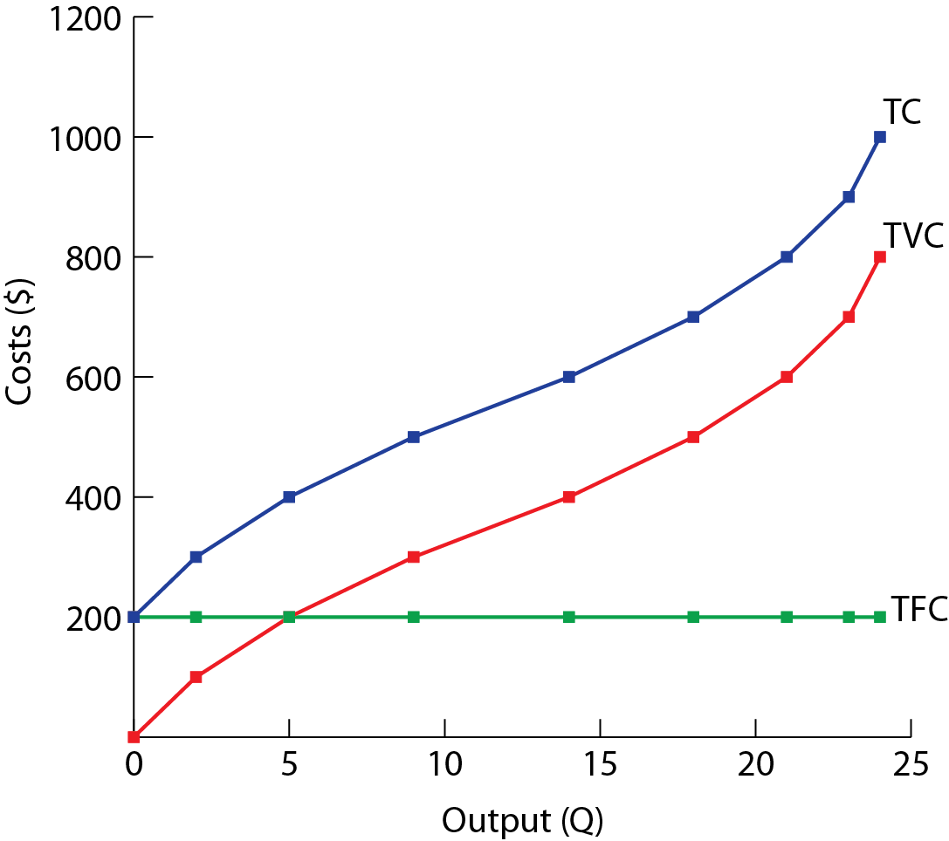
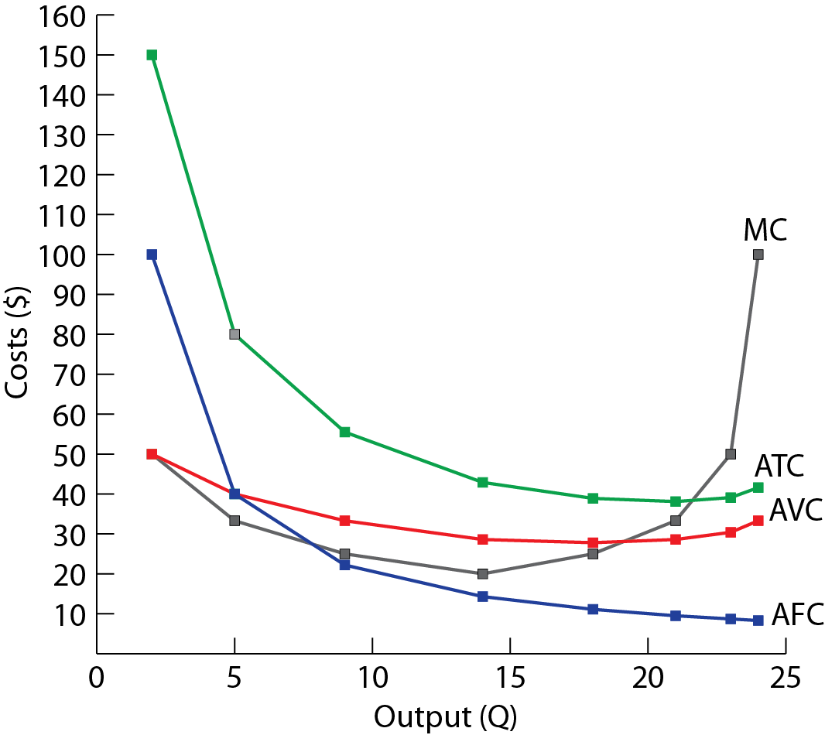

Slide 10
Summary
Concept | Definition | Equation
Product Concepts
Total product (TP) | The total amount of output produced
Marginal product (MP) | The additional output produced by one additional unit of variable input. | MP = ∆TP ÷ ∆L
Average product (AP) | Output per unit of variable input | AP = TP ÷ L
Cost Concepts
Total cost (TC) | The sum of fixed and variable costs | TC = TFC + TVC
Average fixed cost (AFC) | Fixed cost per unit of output | AFC = TFC ÷ Q
Average variable cost (AVC) | Variable cost per unit of output | AVC = TVC ÷ Q
Average total cost (ATC) | Total cost per unit of output | ATC = AFC + AVC
Marginal cost (MC) | The change in cost arising from one additional unit of output | MC = ∆TC ÷ ∆Q = ∆TVC ÷ ∆Q

